Slide 1

CONSTRUCTION OF VARIABLE FREQUENCY DRIVE FOR THREE-PHASE INDUCTION MOTOR
1

Slide 2

Members: Talha Ahmed (268569)
Syed Mutahir Ali (247727) Advisor: Dr. Ammar Hasan Co-Advisor: Dr. Hasan Arshad Nasir
2

Slide 3

PROBLEM STATEMENT
Indigenously built VFDs having high boost capability for Electric Vehicles and Solar Pumps.
3

Slide 4
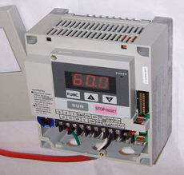
WHAT IS VFD?
VFD controls speed of motor by varying frequency.
Controlled using Sinusoidal Pulse Width Modulation (SPWM).
Variable frequency drive is
Energy efficient
Economical
Variable Frequency Drive
https://upload.wikimedia.org/wikipedia/commons/4/45/Small_variable-frequency_drive.jpg
4

Slide 5
GOALS AND OBJECTIVES
Controlling speed of motor of Electric Vehicles.
01
Reducing energy consumption by induction motor.
02
Controlled starting, stopping and acceleration.
03
5

Slide 6
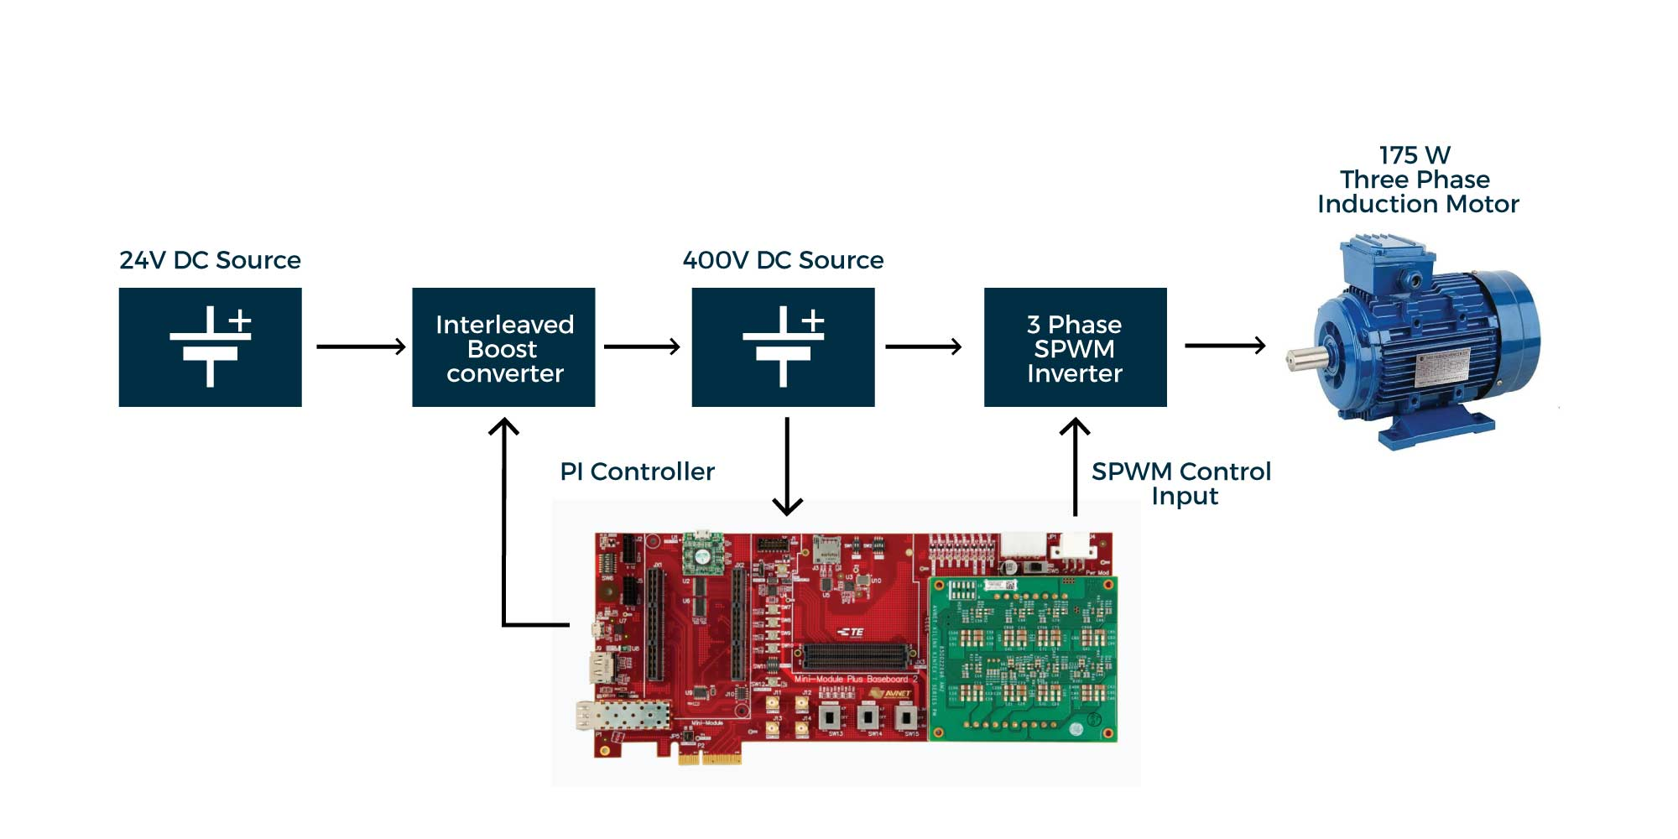
BLOCK DIAGRAM
6

Slide 7
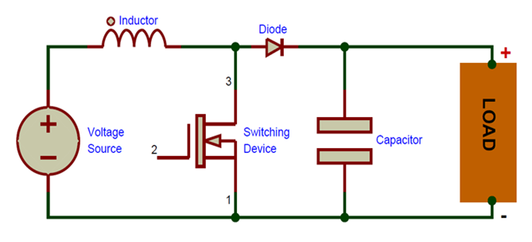
BOOST CONVERTER
The boost converter step up input dc voltage.
Power | 192W
Voltage
Input | 24V
Output | 400V
Current
Input | 8A
Output | 0.48A
Simple Boost Converter
https://components101.com/asset/sites/default/files/components/Boost-Converter.png
7

Slide 8
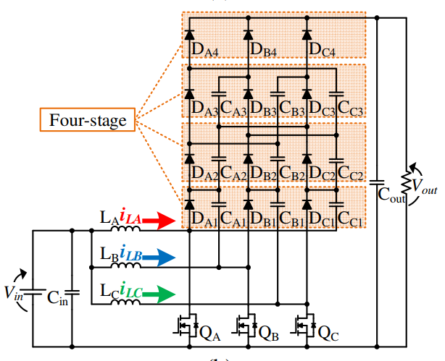
WHY INTERLEAVED BOOST CONVERTER?
Advantages of design
Highly flexible.
Automatic current balancing.
Reduced voltage stresses of semiconductor.
Increase current capability
Increase number of phases.
Increase output voltage
Increase number of stages.
8

Slide 9
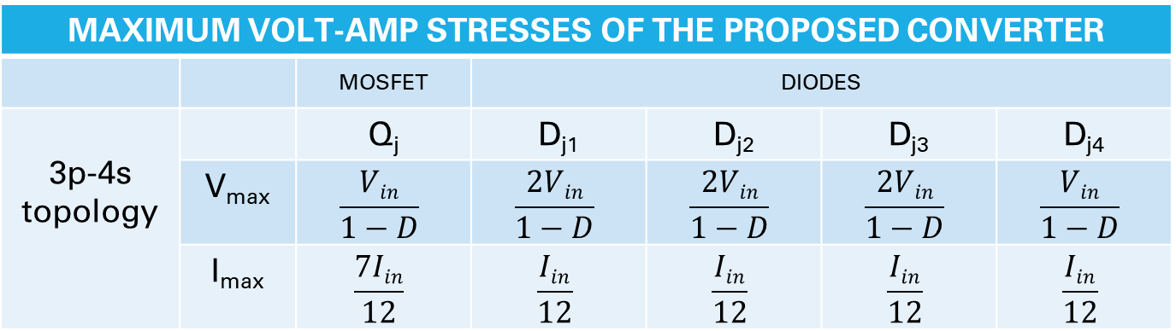

INTERLEAVED BOOST
Output Conversion Ratio
$$Vout=\frac{4Vin}{1−D}$$
MAXIMUM VOLT-AMP STRESSES OF THE PROPOSED CONVERTER
 |  | _{MOSFET} | _{DIODES}
3p-4s topology |  | Q_{j} | D_{j1} | D_{j2} | D_{j3} | D_{j4}
 | V_{max} | $$\frac{Vin}{1−D}$$ | $$\frac{2Vin}{1−D}$$ | $$\frac{2Vin}{1−D}$$ | $$\frac{2Vin}{1−D}$$ | $$\frac{Vin}{1−D}$$
 | I_{max} | $$\frac{7Iin}{12}$$ | $$\frac{Iin}{12}$$ | $$\frac{Iin}{12}$$ | $$\frac{Iin}{12}$$ | $$\frac{Iin}{12}$$
9

Slide 10
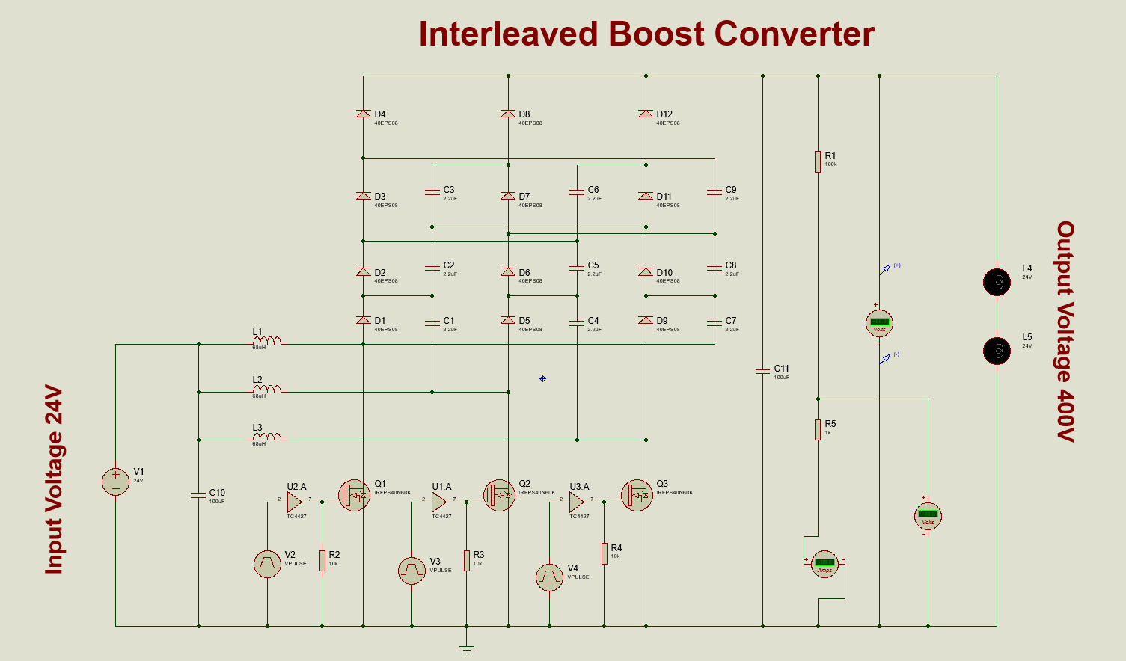
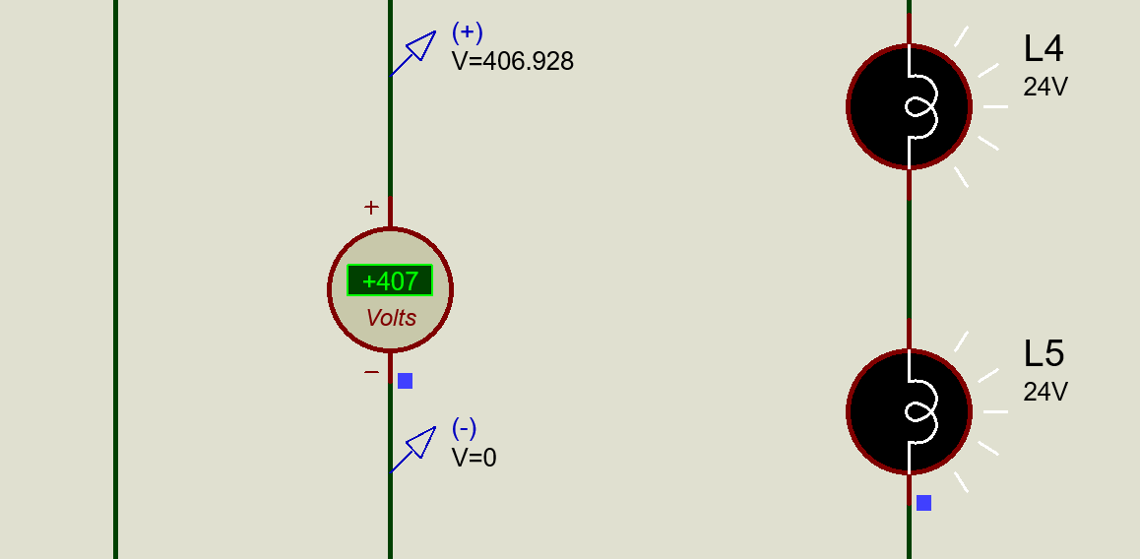
CIRCUIT DESIGN PROTEUS
Mosfet IRFPS40N60K Diode 15ETH06
Gate Driver IC TC4427
Inductor 68uH
Capacitor 2.2uF,100uF
10

Slide 11

SIMULATIONS OF BOOST CONVERTER
11

Slide 12
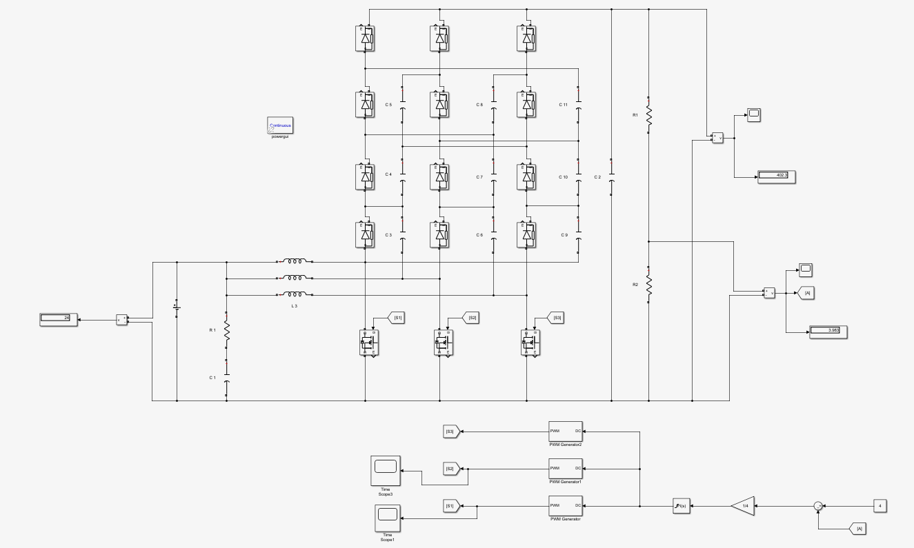
12

Slide 13
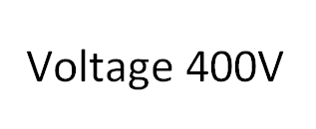
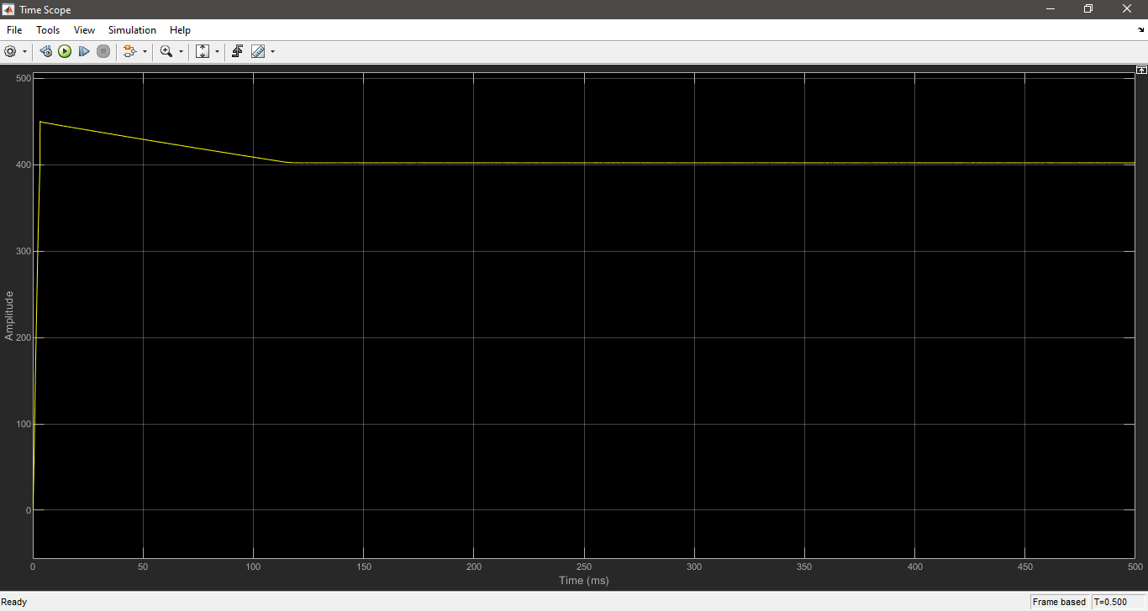
VOLTAGE OUTPUT
13

Slide 14
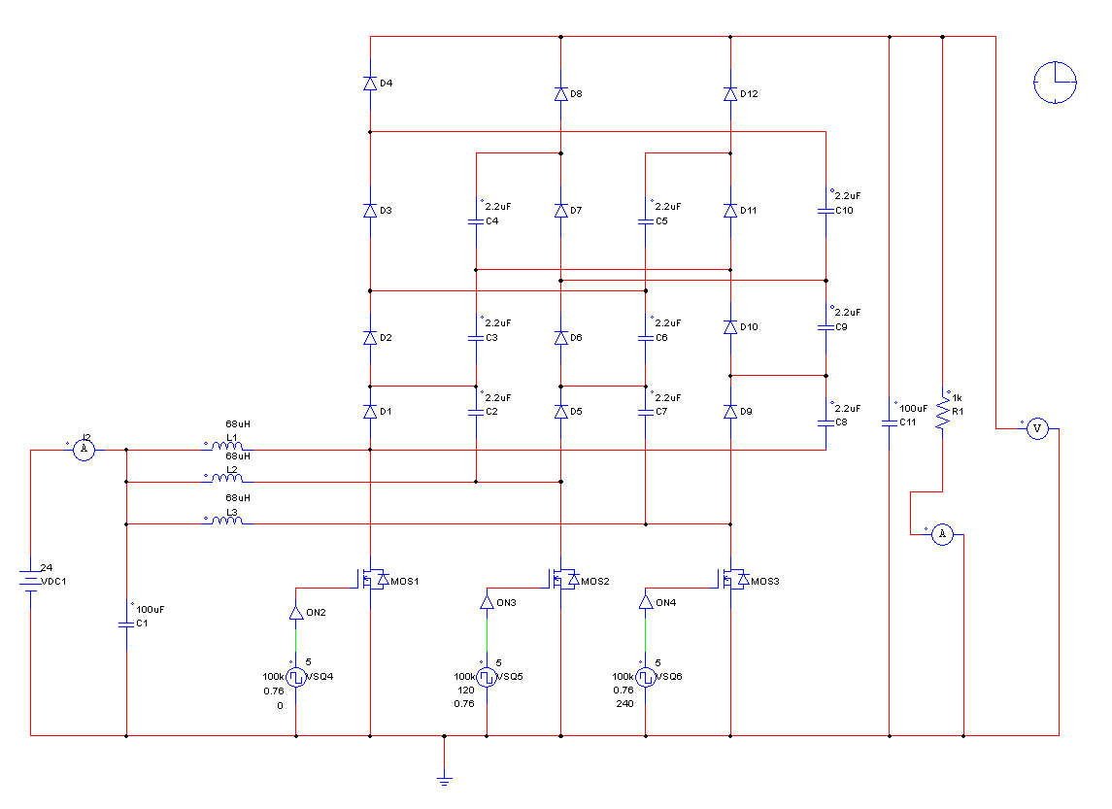
14

Slide 15
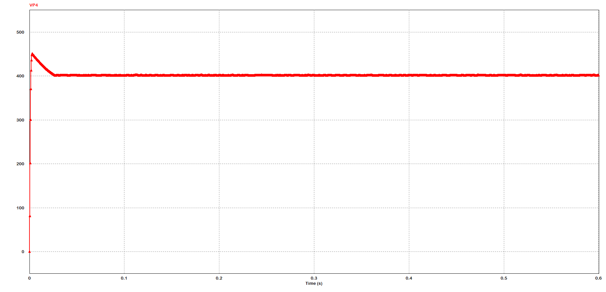
VOLTAGE OUTPUT
15

Slide 16

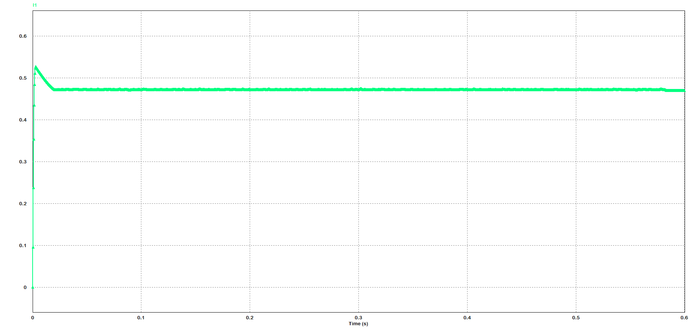
CURRENT OUTPUT
16

Slide 17
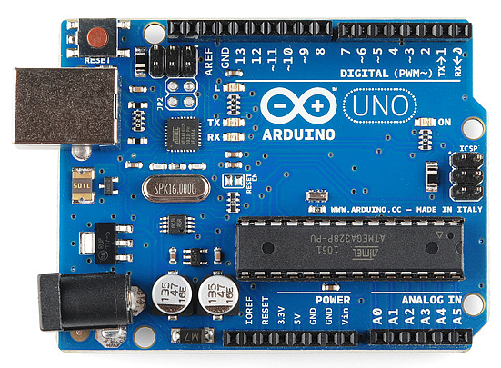
PI CONTROLER
PI controller gives required working point of Boost converter.
K_{p} = Proportional parameter is used to decrease the rise time.
K_{i} = Integral parameter is used to eliminate the overshoot and settling time.
https://www.google.com/url?sa=i&url=https%3A%2F%2Flearn.sparkfun.com%2Ftutorials%2Fwhat-is-an-arduino%2Fall&psig=AOvVaw3VCtJNxpeyF02-gl2zLSid&ust=1647367488307000&source=images&cd=vfe&ved=0CAsQjRxqFwoTCKiO5KKYxvYCFQAAAAAdAAAAABAJ
17

Slide 18
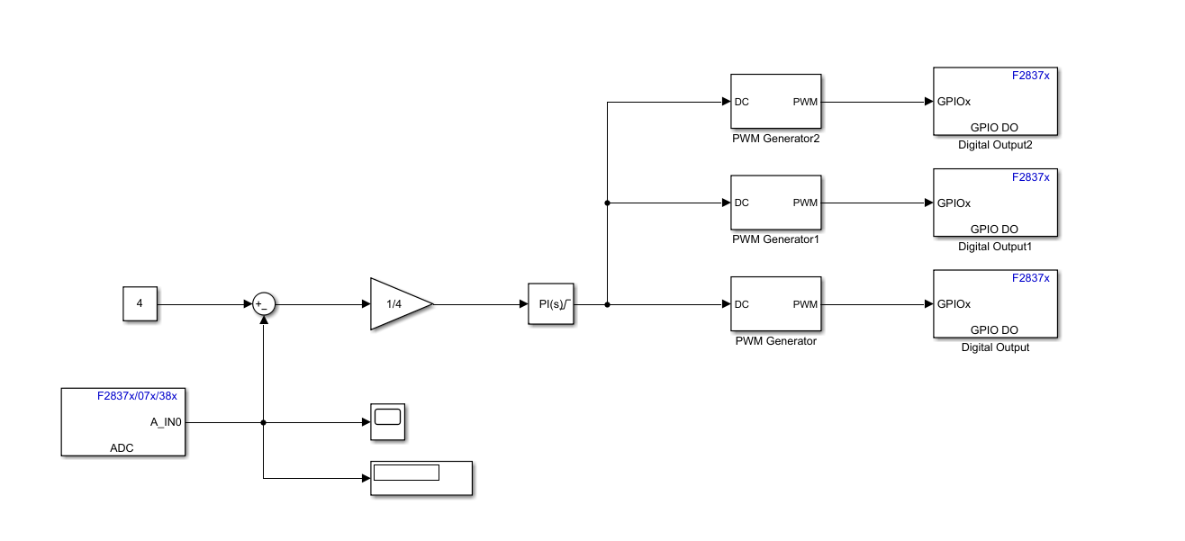
PI CONTROLLER DELFINO BOARD
18

Slide 19
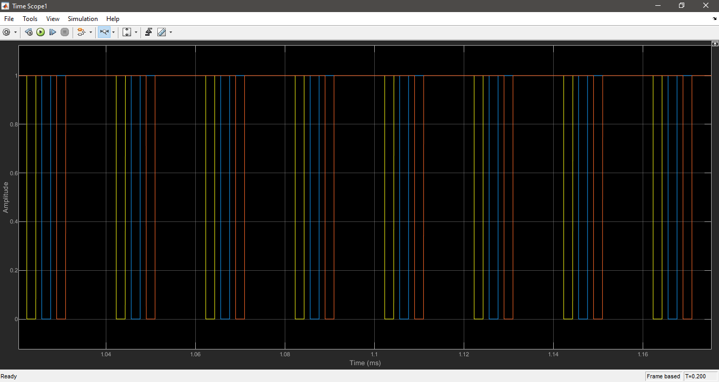
PI CONTROLLER OUTPUT
19

Slide 20
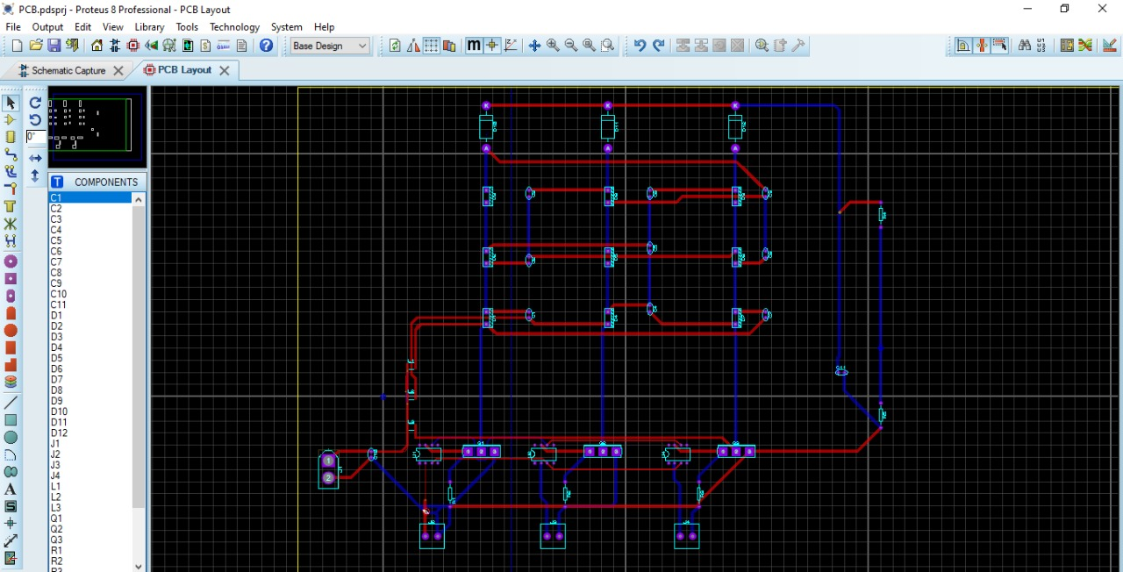
PCB CIRCUIT DESIGN
20

Slide 21
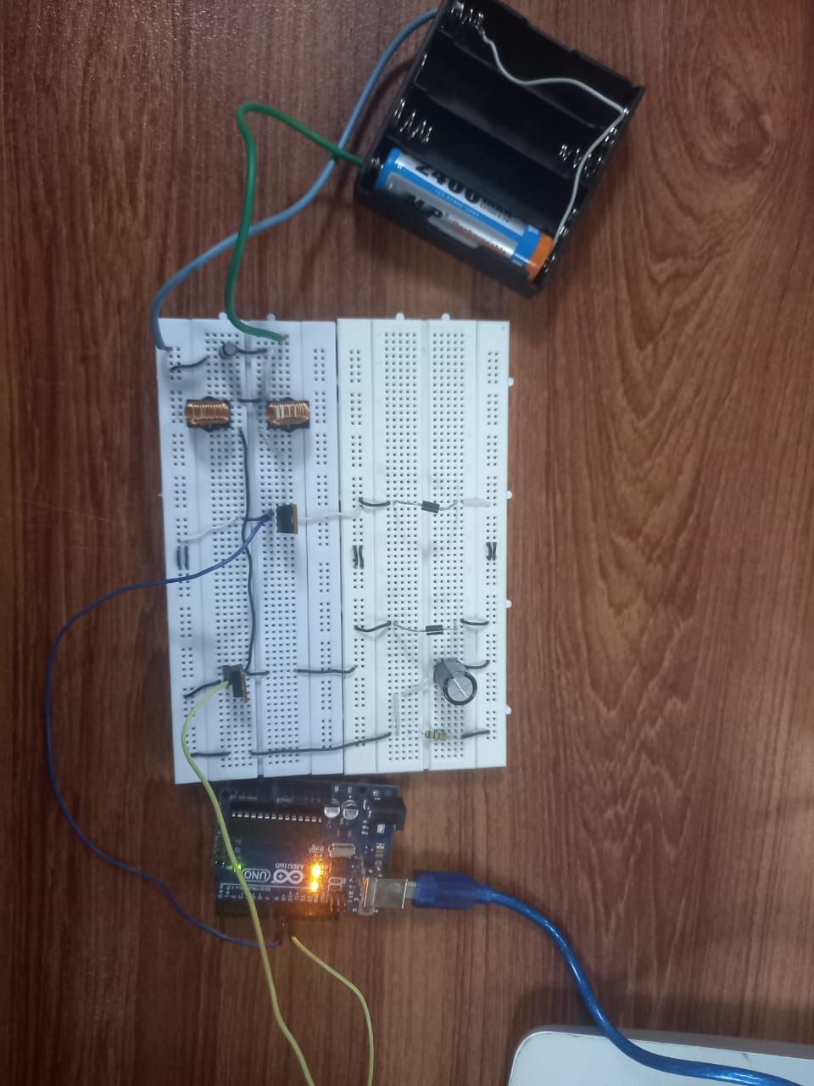
CIRCUIT PROTOTYPE
21

Slide 22
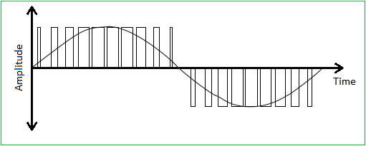
SPWM INVERTER
Used to convert dc voltage into ac voltage.
Power Electronic Switches
Switching at high speed
Change's frequency
Uses sinusoidal Pulse Width Modulation
Create approximate sine wave
Implementation at high power.
Sine Wave (PWM)
22

Slide 23
SPWM INVERTER
The SPWM is realized by comparing a sine wave reference signal (V_{r}) with a high frequency triangular wave carrier signal (V_{c}).
When the reference signal is compared with the carrier signal, their intersection determines the switching instants of the inverter switches.
23

Slide 24
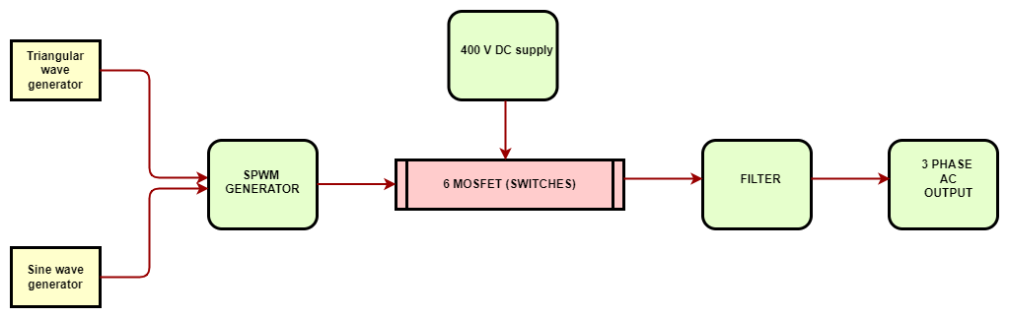
BLOCK DIAGRAM OF SPWM INVERTER
24

Slide 25
WHY SPWM ?
Controlling inverter output frequency.
Square Wave Produced causes greater humming noise which produces heating effect and can result in damage of electrical appliance.
Using SPWM, output is very close to pure AC current.
25

Slide 26
SIMULATIONS OF INVERTER
26

Slide 27
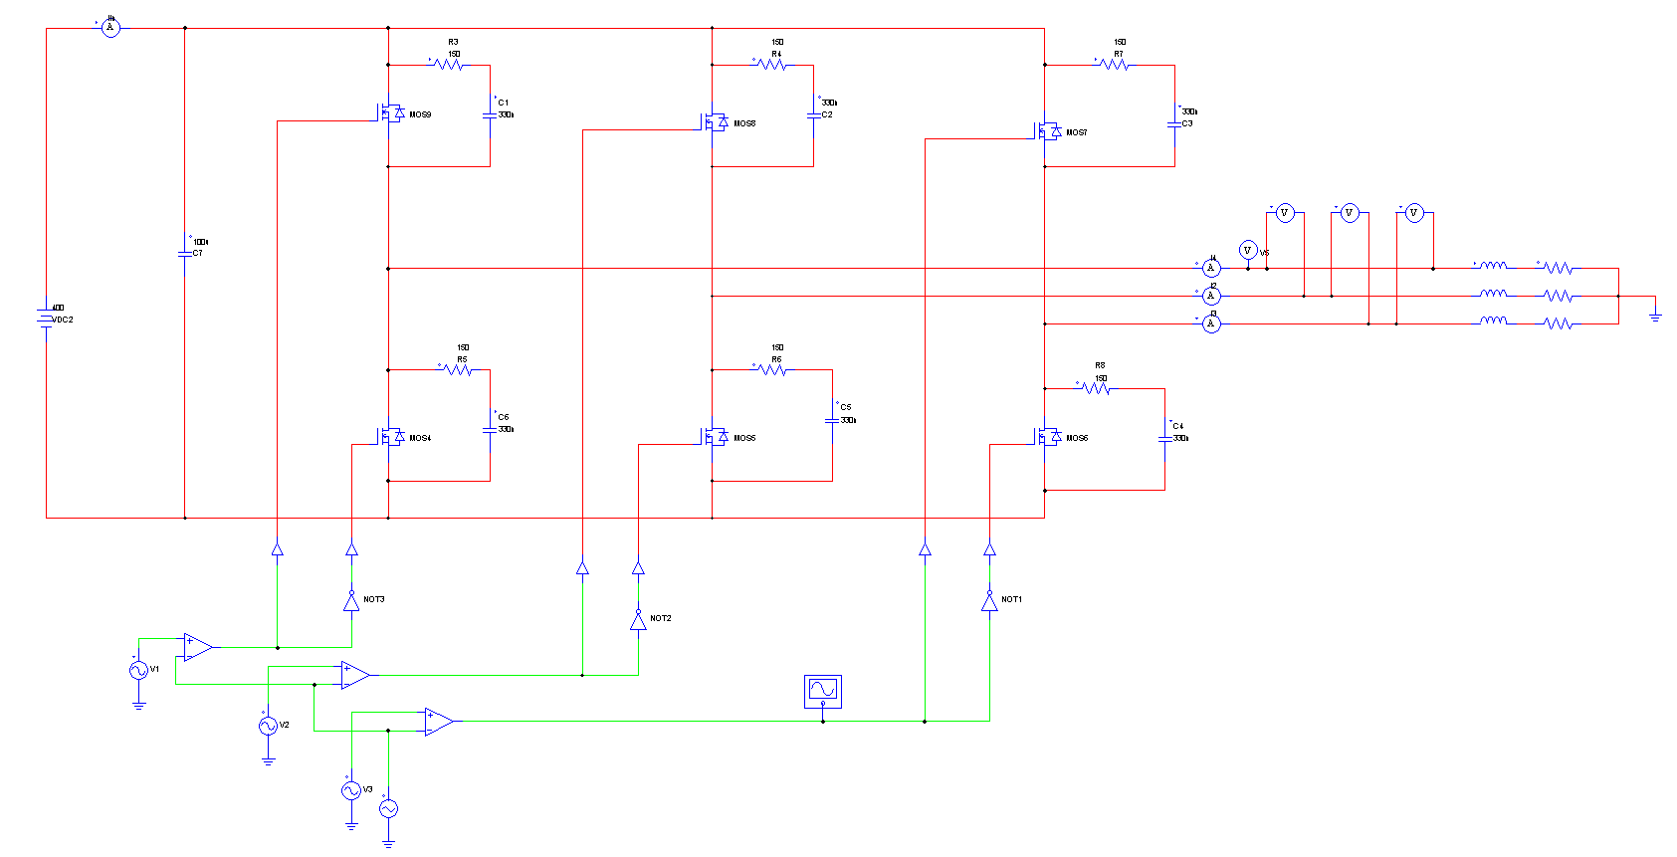
CIRCUIT DIAGRAM
27

Slide 28
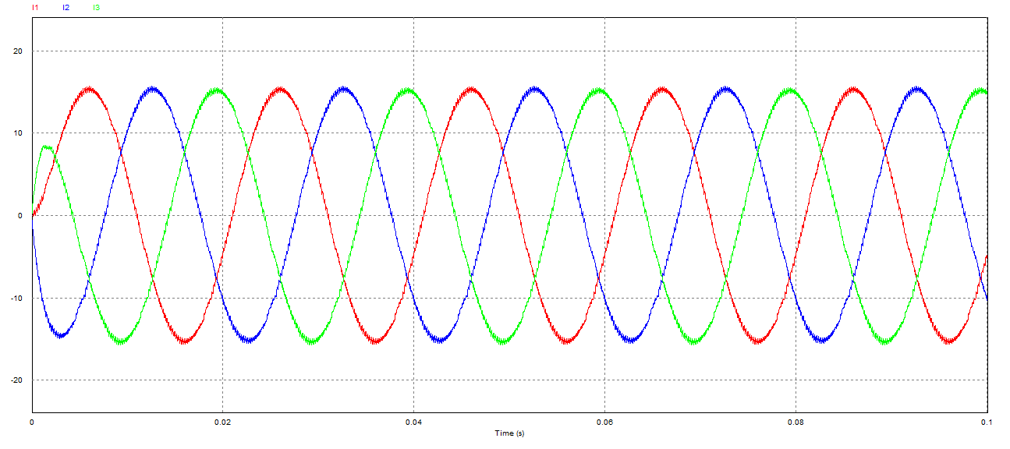
CURRENT OUTPUT
28

Slide 29
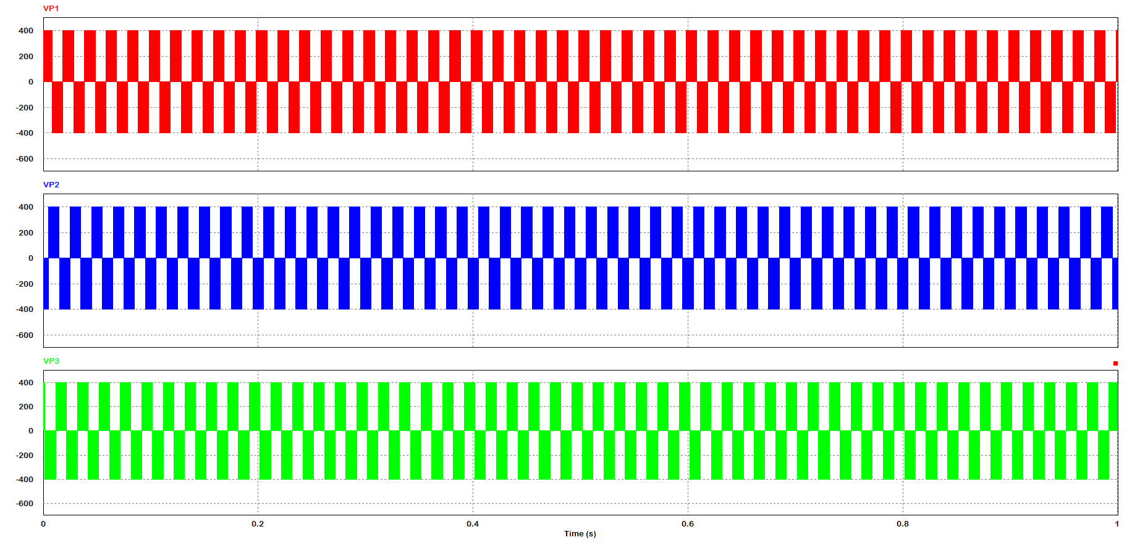
VOLTAGE OUTPUT
29

Slide 30
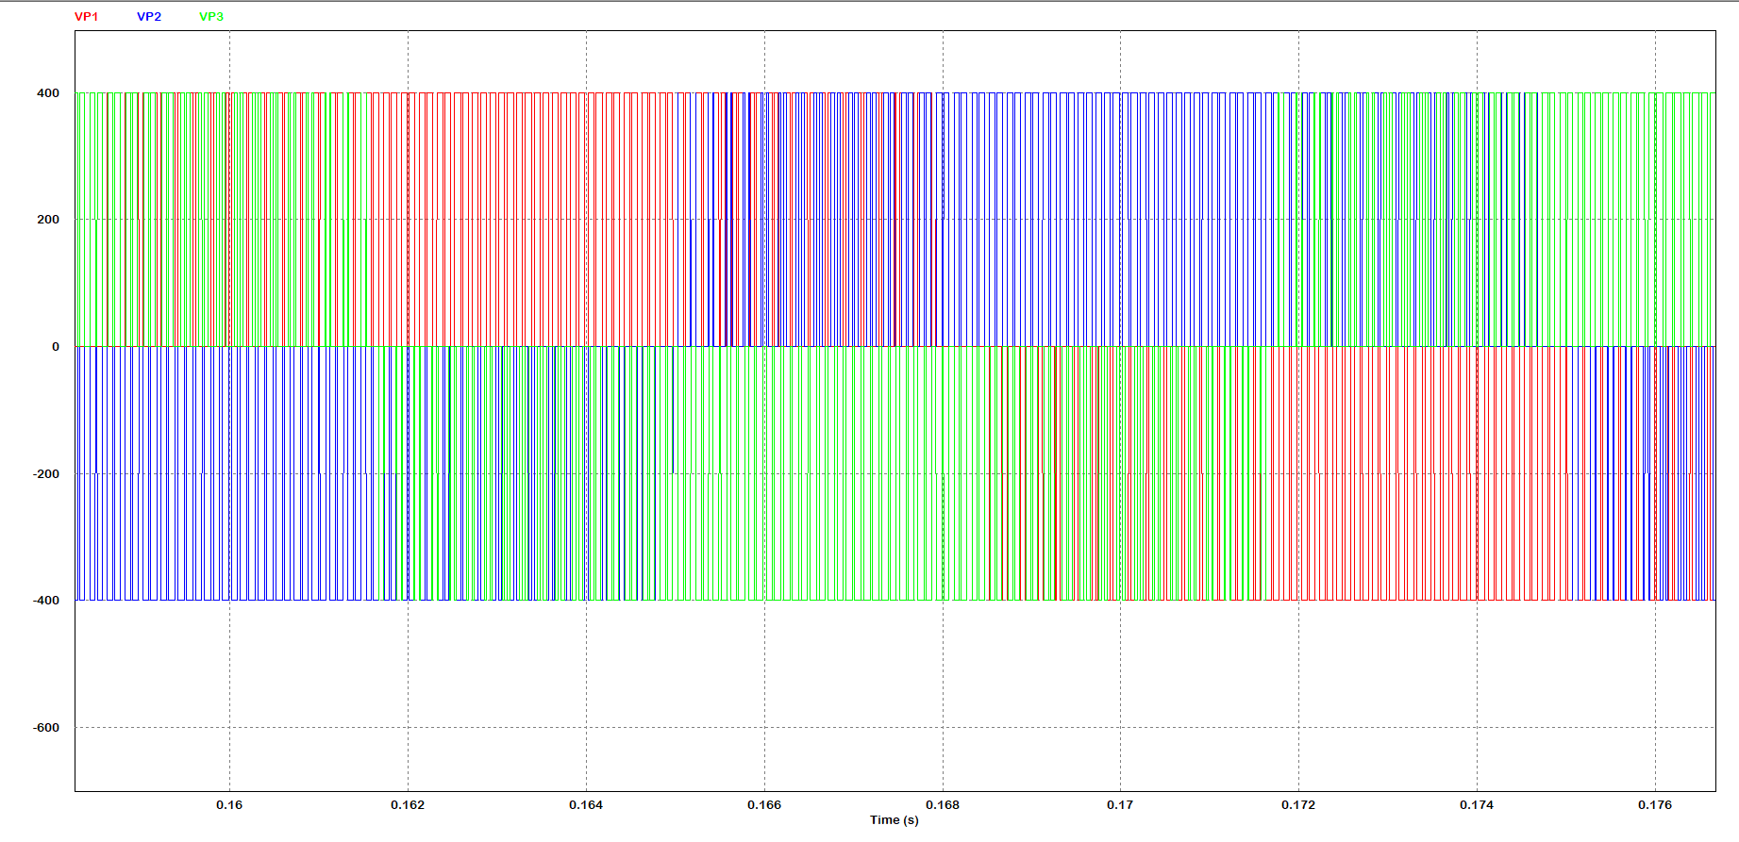
VOLTAGE OUTPUT
30

Slide 31
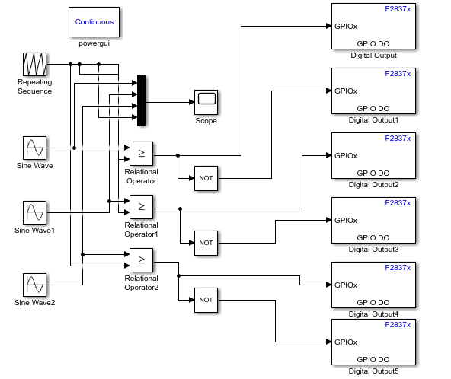
SPWM CONTROL DELFINO BOARD
31

Slide 32
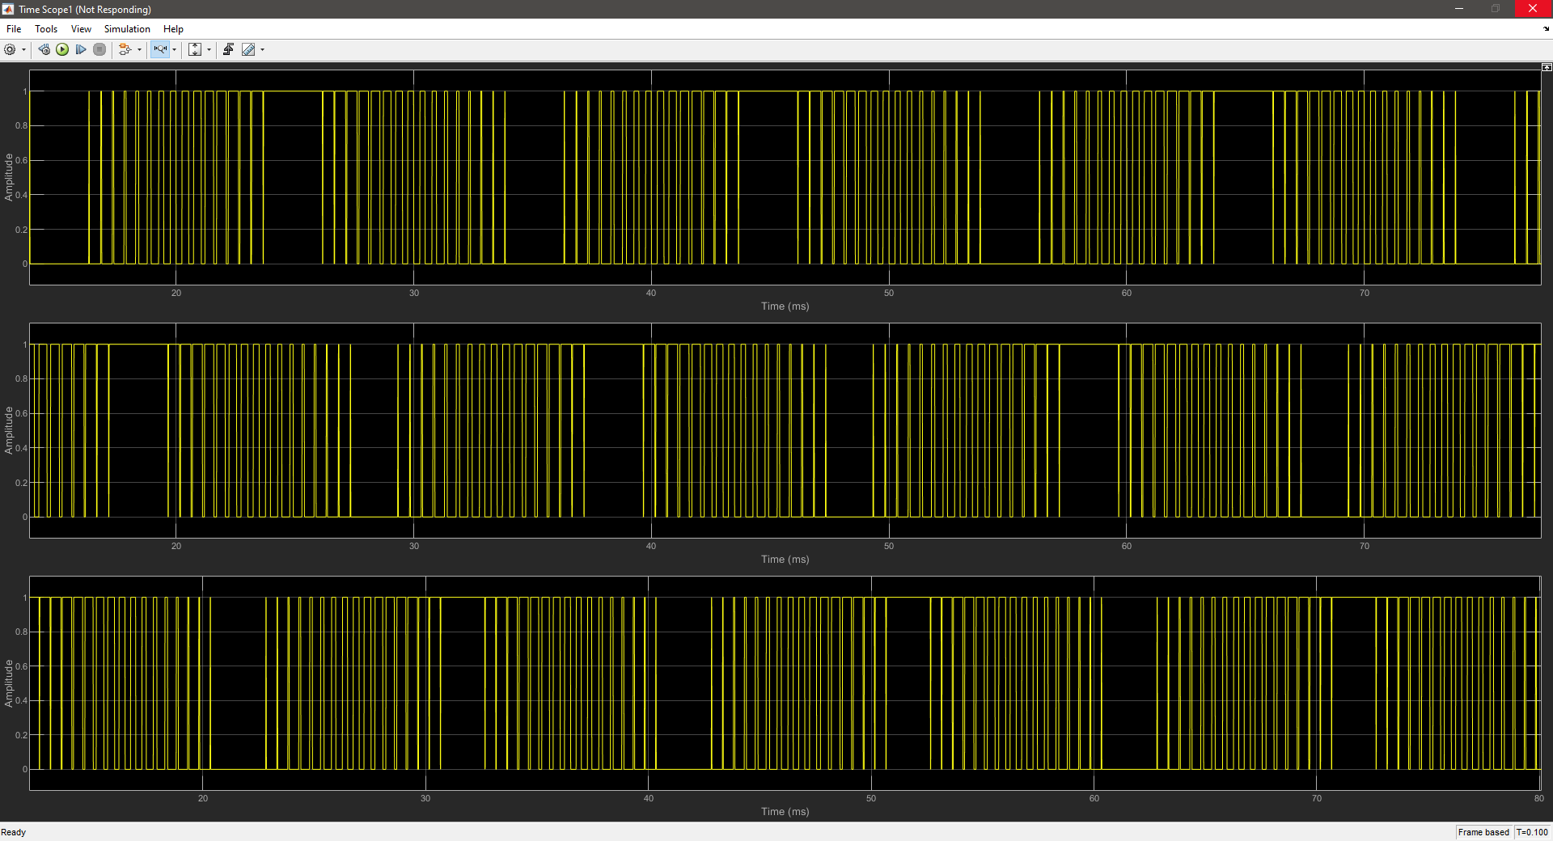
SPWM CONTROL OUTPUT
32

Slide 33
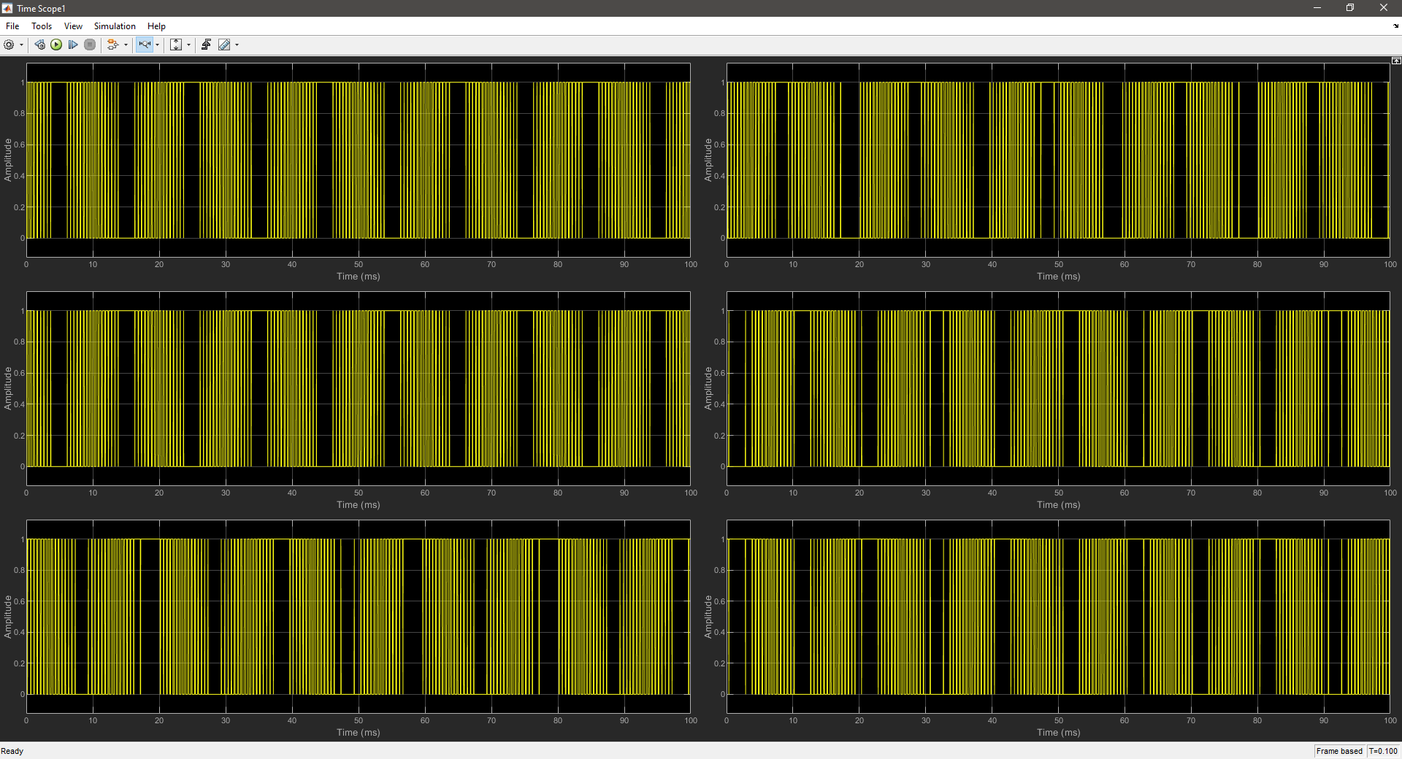
SPWM CONTROL OUTPUT
33

Slide 34
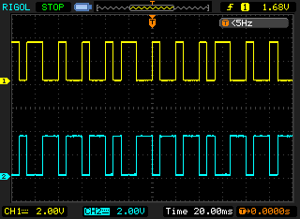
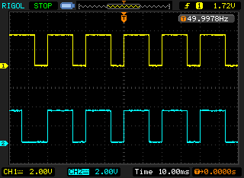
SPWM CONTROL OUTPUT
S1 and S4 input
S1 and S2 input
34

Slide 35
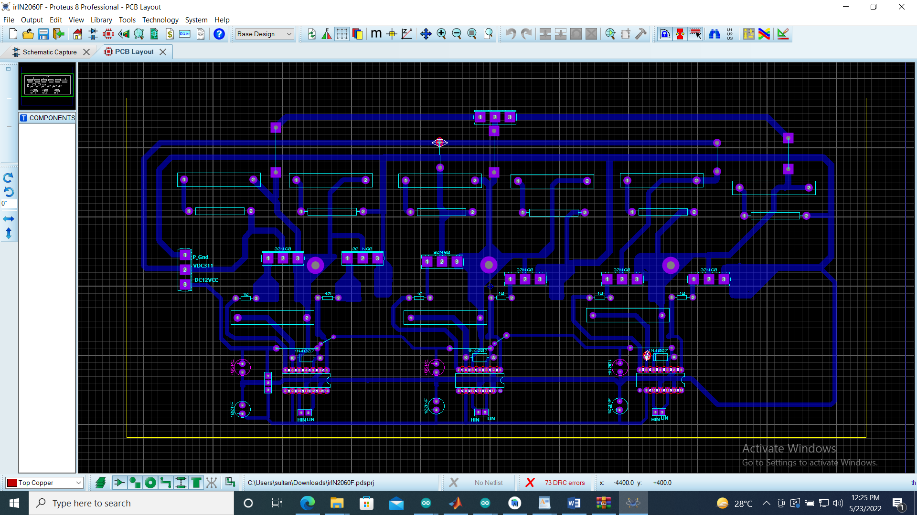
PCB CIRCUIT DESIGN
35

Slide 36

TARGET CONSUMER
High Power VFD
Electric Vehicles
Air conditioners
Boilers pumps
Compressors
Agricultural Sector
Water pumping
36

Slide 37





SOFTWARES USED
37

Slide 38
REFRENCES
K. Koyama, Y. Tada and M. Uno, "Highly Extendable Interleaved High Step-Up Boost Converter with Automatic Current Balancing and Reduced Semiconductor Voltage Stresses for Renewable Energy Systems," IECON 2020 The 46th Annual Conference of the IEEE Industrial Electronics Society, 2020, pp. 1335-1341, doi: 10.1109/IECON43393.2020.9254656.
T. Bhattacharjee, M. Jamil and A. Jana, "Design of SPWM based three phase inverter model," 2018 Technologies for Smart-City Energy Security and Power (ICSESP), 2018, pp. 1-6, doi: 10.1109/ICSESP.2018.8376696.
Lakshmanan S.A., B. S. Rajpourhit and A. Jain, "Modeling and analysis of 3-phase VSI using SPWM technique for grid connected solar PV system," 2014 IEEE Students' Conference on Electrical, Electronics and Computer Science, 2014, pp. 1-6, doi: 10.1109/SCEECS.2014.6804530.
38

Slide 39

39

Slide 40
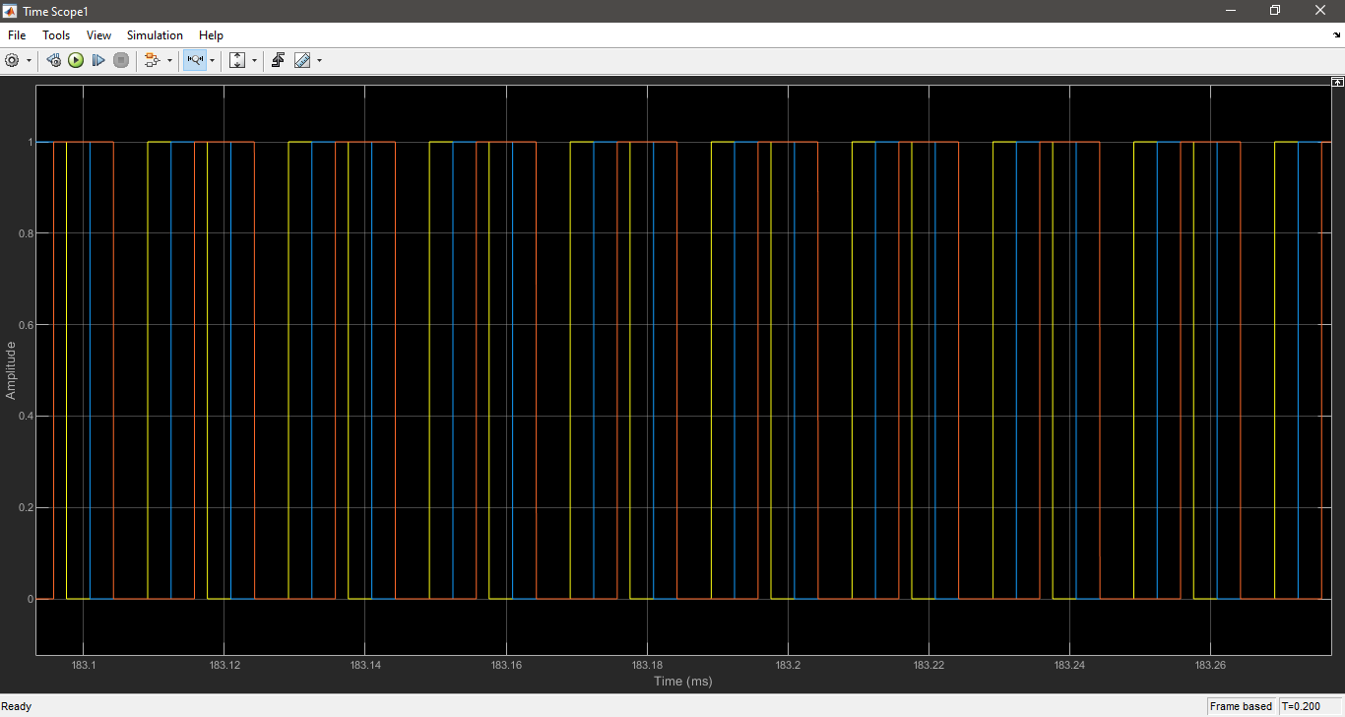
PI CONTROLLER OUTPUT(Voltage Stable)
40

Slide 41
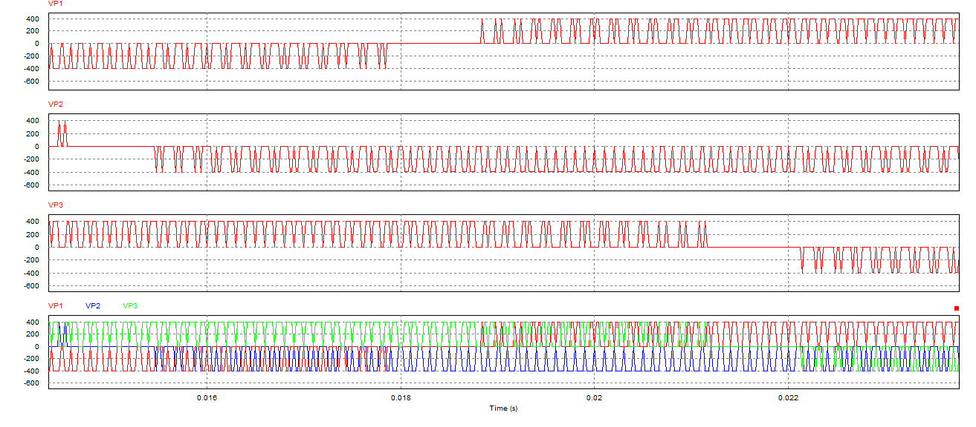
VOLTAGE OUTPUT (INVERTER)
41

Slide 42
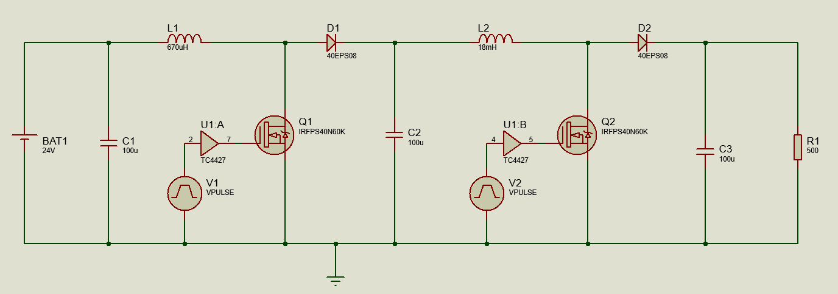
CASCADED BOOST CONVERTER
42

Slide 43
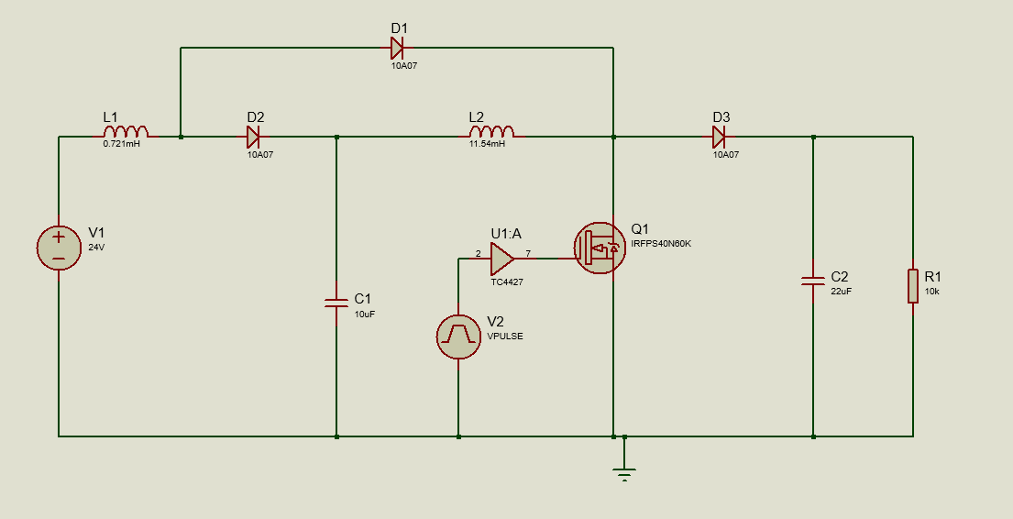
QUADRATIC BOOST CONVERTER
43

Slide 44
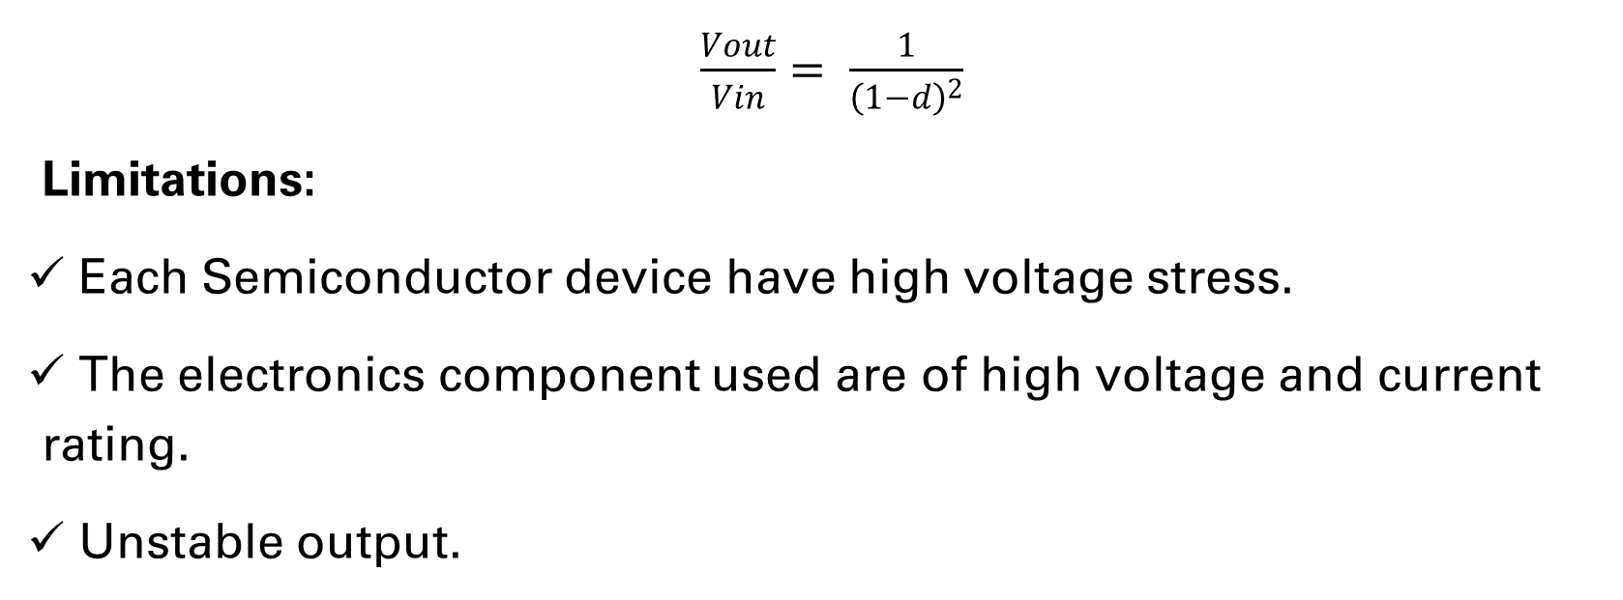
CONTINUED
$\frac{Vout}{Vin}= \frac{1}{{\left(1−d\right)}^{2}}$
Limitations:
Each Semiconductor device have high voltage stress.
The electronics component used are of high voltage and current rating.
Unstable output.
44

Slide 45
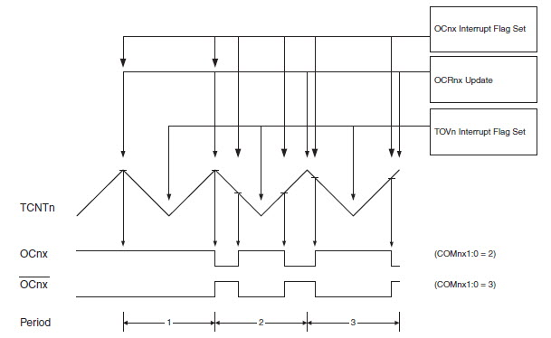
Phase Correct PWM
45

Slide 46
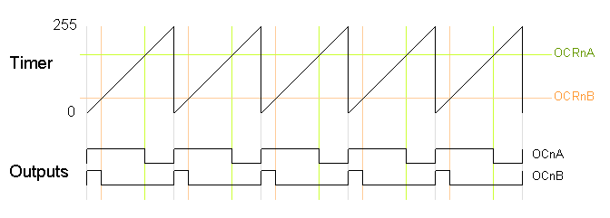
FAST PWM
46

Slide 47
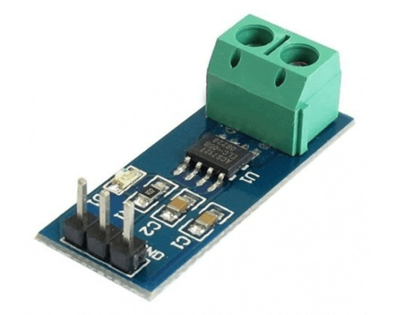
ACS 712 SENSOR
Protectionary circuit for converter.
Acs712 sensor is used for this purpose.
Working Principal
If current in circuit exceed set limit Arduino off the mosfet.
Under normal condition mosfet is on.
https://www.google.com/url?sa=i&url=https%3A%2F%2Fwww.techtonics.in%2Fcurrent-sensor-module-acs712-30a&psig=AOvVaw3OJlf5MaVa3pJHFtAAGAN_&ust=1647364883151000&source=images&cd=vfe&ved=0CAsQjRxqFwoTCNCBwceOxvYCFQAAAAAdAAAAABAz
47

Slide 48

PRICING
Delfino Board – Rs. 13,000
PCB – Rs. 4,000
MOSFETs – Rs. 1600
Diodes – Rs. 390
Capacitors – Rs. 690
Inductors – Rs. 200
https://egyptinnovate.com/sites/default/files/blog/images/Perezbox-Pricing.jpg
48

